Slide 1

PRODUCT SHIPMENT TRACKING
Build a Classification Machine Learning Model. On the electronic products, that the product will reach on time or not.

Slide 2
Introduction
Product shipment tracking is crucial for businesses to ensure timely delivery to customers. In this presentation, we’ll explore a classification task focused on whether shipments reached their destination on time or not (0 for on time and 1 for not on time
Notes:
This template can be used as a starter file to give updates for project milestones.
Sections
Right-click on a slide to add sections. Sections can help to organize your slides or facilitate collaboration between multiple authors.
Notes
Use the Notes section for delivery notes or to provide additional details for the audience. View these notes in Presentation View during your presentation.
Keep in mind the font size (important for accessibility, visibility, videotaping, and online production)
Coordinated colors
Pay particular attention to the graphs, charts, and text boxes.
Consider that attendees will print in black and white or grayscale. Run a test print to make sure your colors work when printed in pure black and white and grayscale.
Graphics, tables, and graphs
Keep it simple: If possible, use consistent, non-distracting styles and colors.
Label all graphs and tables.

Slide 3
Data Source
The dataset used for model building contained 10999 observations of 12 variables. The information is about past shipments, including variables such as customer rating, product importance, customer care calls, warehouse block, mode of shipment, cost of the product (US Dollars), Gender, Discount offered & reached on time (target variable).
Notes:
What is the project about?
Define the goal of this project
Is it similar to projects in the past or is it a new effort?
Define the scope of this project
Is it an independent project or is it related to other projects?
* Note that this slide is not necessary for weekly status meetings

Slide 4
Data Analysis
We will perform exploratory data analysis (EDA), feature engineering, Data splitting, Hyperparameter Tuning, and build machine learning model to predict that the shipment will be on time or not.
EDA
Feature engineering
machine learning model

Slide 5
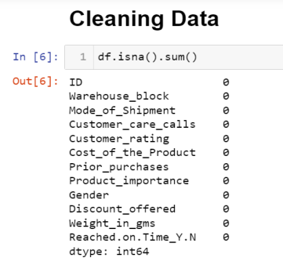
Exploratory Data Analysis (EDA):-
We found out that there is no missing value in our data
Notes:
The following slides show several examples of timelines using SmartArt graphics.
Include a timeline for the project, clearly marking milestones, important dates, and highlight where the project is now.

Slide 6
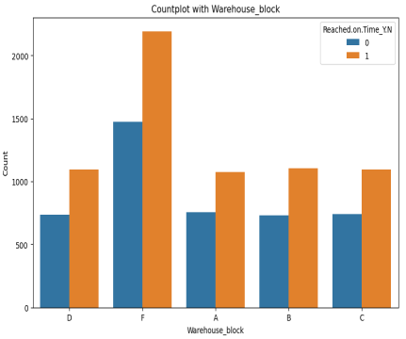
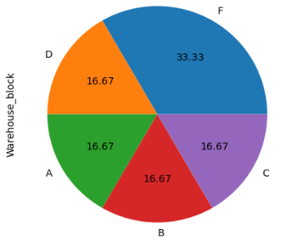
Visualization
While visualization on warehouse block it is clearly visible that block F is highest, which shows delivery status featuring with target variable i.e Reached on time attribute. Whereas 1 & 0 represents not on time & on time respectively.
Notes:
* If any of these issues caused a schedule delay or need to be discussed further, include details in next slide.

Slide 7
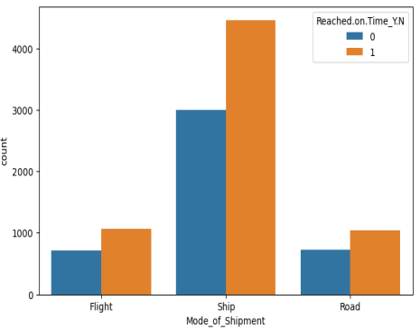
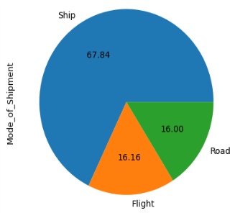
Visualization on Mode of Shipment:-
While visualization on MODE OF SHIPMENT we can see that mode of SHIP has the highest delivery status featuring with target variable i.e Reached on time attribute. Whereas 1 & 0 represents not on time & on time respectively.
Notes:
Duplicate this slide as necessary if there is more than one issue.
This and related slides can be moved to the appendix or hidden if necessary.

Slide 8
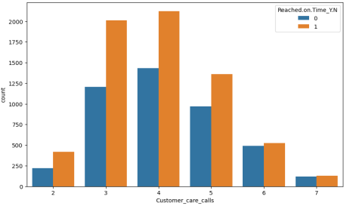
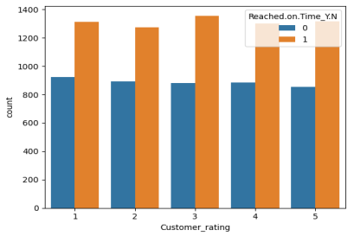
Visualization on customer care calls and customer rating:-
The customer care calls attribute has:- The number of calls made from enquiry for enquiry of the shipment.
While visualization on CUSTOMER CARE CALLS we can see that those who have made maximum number of calls has the equal delivery status.
While on the other side CUSTOMER RATING has the equal delivery status featuring with target variable i.e Reached on time attribute. Whereas 1 & 0 represents not on time & on time respectively.

Slide 9
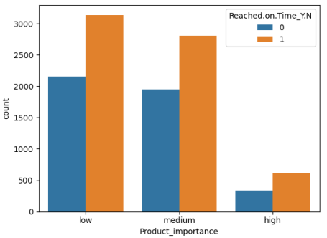
Visualization on Product Importance:-
As we can see when the PRODUCT IMPORTANCE is high distribution in delivery status is less as compared to the others. And when the product importance is low has the highest delivery status and distribution, featuring with target variable i.e Reached on time attribute. Whereas 1 & 0 represents not on time & on time respectively.

Slide 10
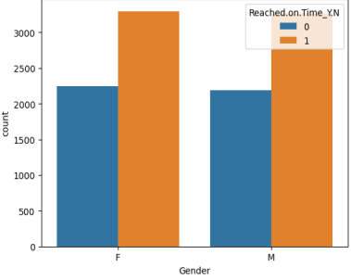
Visualization with GENDER column
As i can see the Gender column is equal in our data. Also both the gender's product arrived late is more than delivered on time.
GENDER attibute featuring with target variable i.e Reached on time attribute. Whereas 1 & 0 represents not on time & on time respectively.
Notes:
What are the dependencies that affect the timeline, cost, and output of this project?

Slide 11
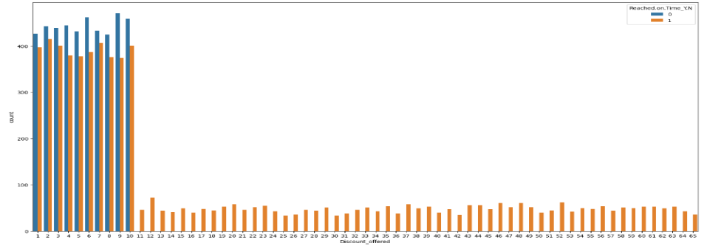
Visualization with DISCOUNT OFFERED
While visualization on DISCOUNT OFFERED we can see that when offering discount, delivery status reached on time is more. The numbers who encountered high on time delivery than late delivery are between 1 to 10. While above 10 the product has never reached on time or arrived late.
Here in the plot after Discount Offered on products delivery on time tends to rise.
Notes:
Prepare slides for the appendix in the event that more details or supplemental slides are needed. The appendix is also useful if the presentation is distributed later.

Slide 12

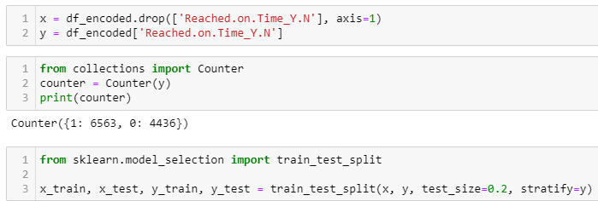
Now I tried using ONE HOT ENCODING for my data
After applying one hot encoding I saved this into a new df_encoded.
Train Test Splitting

Slide 13
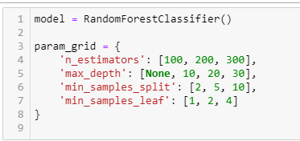

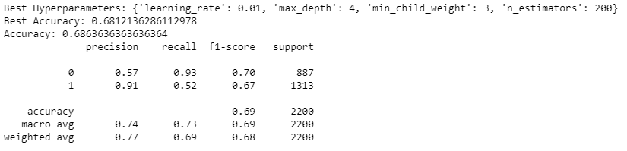
RandomForestClassifier with GridSearchCV:- Using possible Hyperparameters
XGBoost (Extreme Gradient Boosting) with GridSearchCV
Using possible Hyperparameters

Slide 14
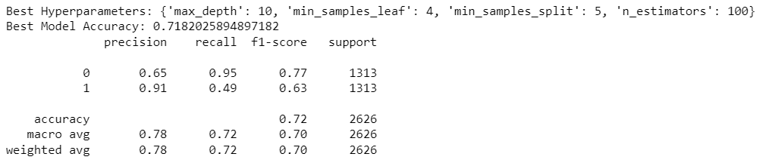
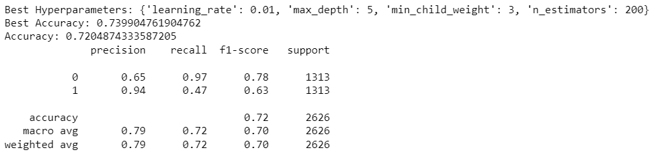
To improve my accuracy I tried oversampling using smote algorithm
RandomForestClassifier with GridSearchCV on OverSampled Data:-
XGBoost with GridSearchCV on OverSampled Data:-
Using possible Hyperparameters

Slide 15
CONCLUSION:-
I found out that the XGB performs good in my dataset. As I also tried using logistic, KNN and other classification algorithm but this didn’t given me good accuracy before and after over sampling. So here I can conclude that XGB is the best model as it has given 72%

